Slide 1
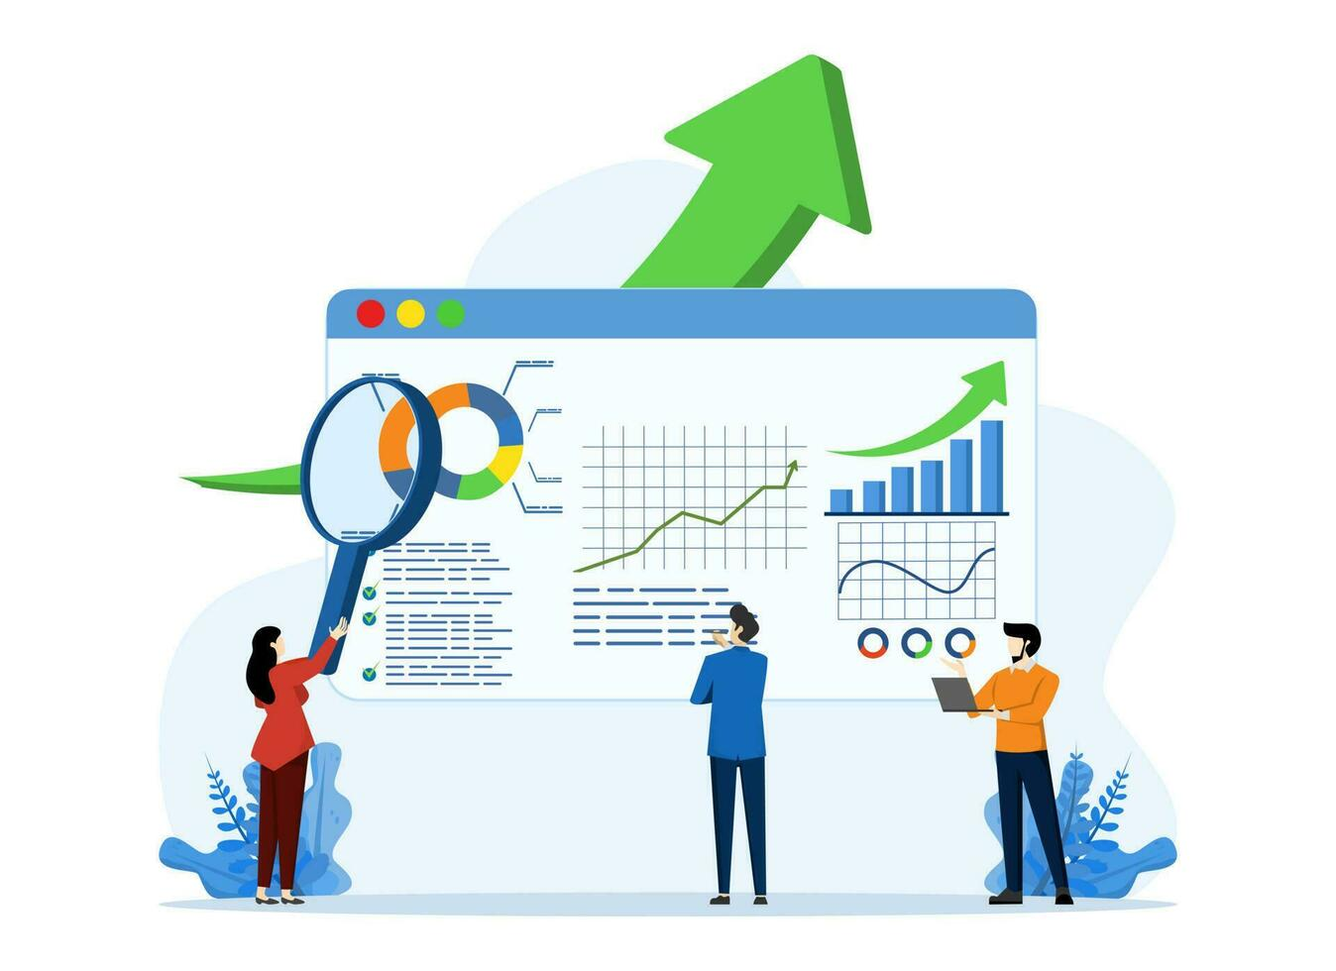
Insurance Analytics
Group 3

Slide 2
Group Members 1) Priyanka Rajesh 2) Prajwal Sonawane 3) Kiran Tandale 4) Navnath Karanjule 5) Abhishek Kodre 6) Avuku Nasaraiah

Slide 3
Branch Dashboard
The Branch Dashboard is designed to facilitate discussions between our Corporate Team and Individual Branch Heads. It's a powerful tool that provides insights into new and renewal business numbers, helping us track and optimize performance at both individual and branch levels.
The dashboard takes data from various sources, such as target sheets, brokerage and fees sheets, invoices, meeting records, opportunity reports, and more. It then calculates and visualizes these metrics to provide a comprehensive overview of branch and individual performance.

Slide 4

KPI List
1-No of Invoice by Account Exec
2-Yearly Meeting Count
3.1Cross Sell--Target, Achieve, new
3.1New-Target,Achive,new
3.1Renewal-Target, Achieve, new
4. Stage Funnel by Revenue
5. No of meeting By Account Exe
6-Top Open Opportunity

Slide 5
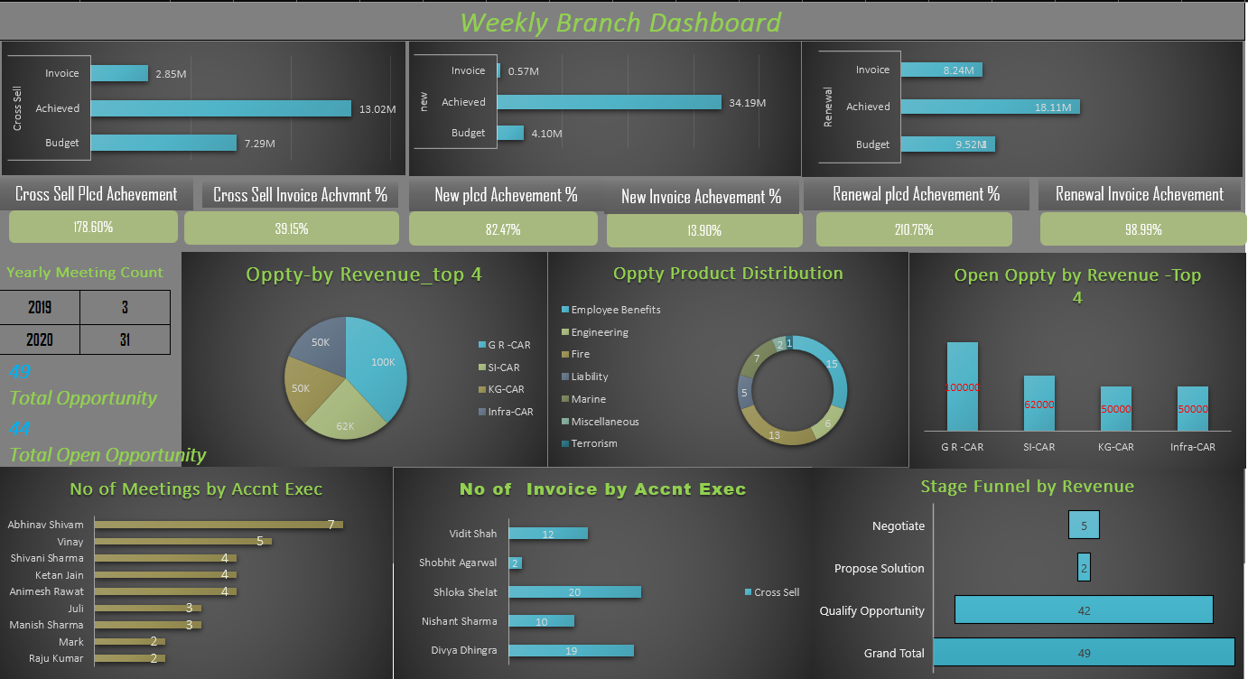
Excel Dashboard

Slide 6
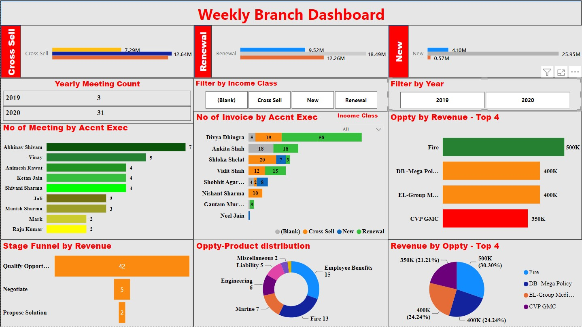
Power BI Dashboard

Slide 7
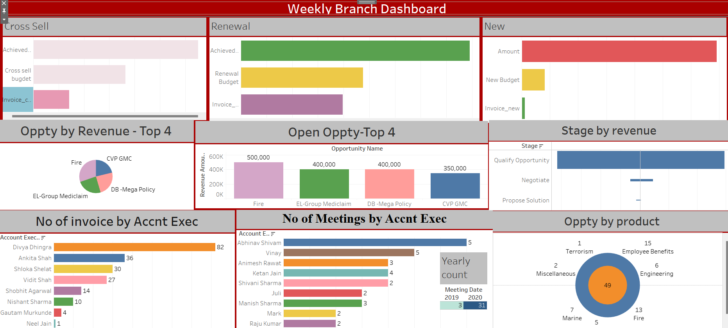
Tableau Dashboard

Slide 8
Insights
High Oppty of Revenue is GR-CAR Approximately(35%)
Employee Benefits and Fire Are Have more Share on oppty Product Distribution
Yearly Meeting Count is increased by (1000%). This graph shows there are few meetings happened in the year 2019 as compared to the year 2020 of the account executive
No of Invoice by Account Executive grapg shows Animesh Rawat have the highest number of invoices while Ketan have lowest number of invoices.
The budget graph shows that Cross sell & Renewal policies have meet and exceeded the target, however the New policies has not achieved the target.
The No of Meeting by Account Executive graph shows that the account executive Abhinav Shivam had more meetings as compared to the other account executives during the specified time.

Slide 9
Conclusion
The Data and Dashboard plays a crucial role to understand valuable insights.
The dashboard takes data from various sources, such as target sheets, brokerage and fees sheets, invoices, meeting records, opportunity reports, and more. It then calculates and visualizes these metrics to provide a comprehensive overview of branch and individual performance. This project has empowered us to make data-driven decisions, optimize strategies, and enhance overall performance across the organization.

Slide 10
Thank You 🙏🏻

